Slide 1

How To Write An Essay
BASIC WRITING
GENERAL ENGLISH 3

Slide 2
What is an Essay?
The main purpose of any essay is to:
discuss
describe
persuade a particular topic
explain
analyze

Slide 3
Essay Structure
An Essay has 3 main parts:
  An introduction (introductory paragraph)
  A body ( at least one, but usually more paragraphs)
  A conclusion (concluding paragraph)

Slide 4
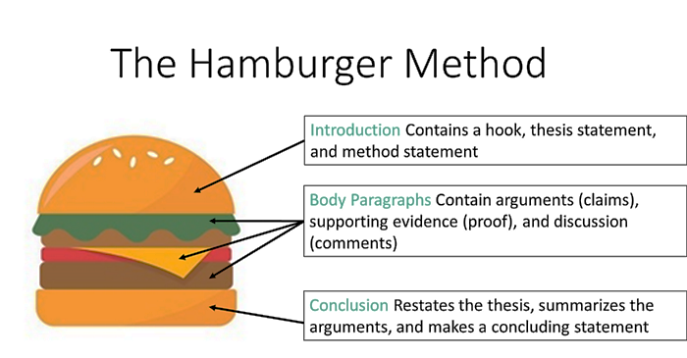
The Basic Essay Structure

Slide 5

Essay Format
Introduction (giới thiệu chung)
Thesis Statement
(Câu mở bài)
Paragrap 1
(Advantages)
Body
Paragrap 1
Disadvantages
Conclusion

Slide 6
Introduction
An introductory paragraph contains two parts.
General Statements: a few sentences about your subject that catches the attention of your readers
Thesis Statement: one sentence that tells your reader the main points of your topic and states the overall “plan” of your essay

Slide 7
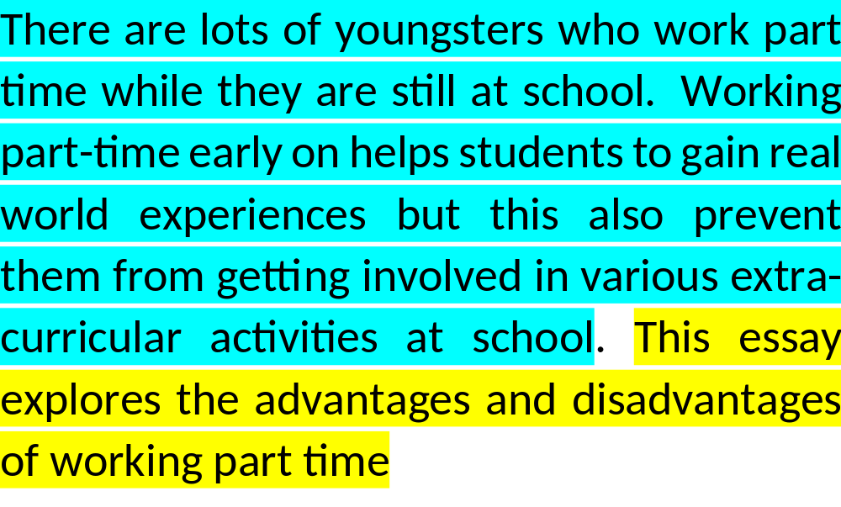
Example: An Introduction
General Statement
Thesis Statement

Slide 8
Body Paragraph
The body paragraphs used to develop the idea expressed in the thesis statement and prove your points
  - Topic sentence
  - supporting sentence
  - Concluding sentence

Slide 9
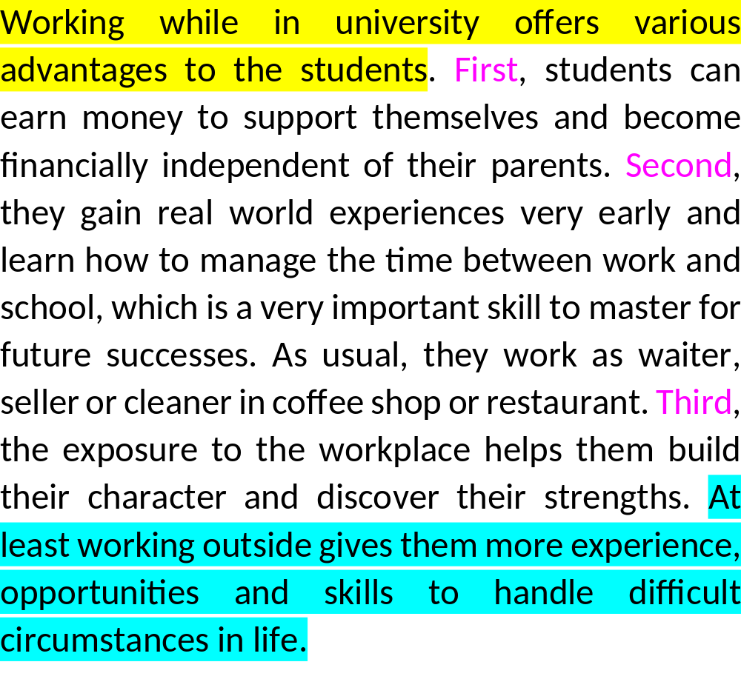
Advantage paragraph
Topic sentence
Supporting sentences
and example
Concluding sentence

Slide 10
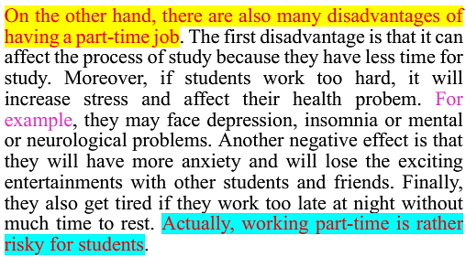
Disadvantage paragraph
Topic sentence
Supporting sentences and example
Concluding sentence

Slide 11


Conclusion
The conclusion paragraph is the last paragraph in the essay. It completes the essay by summarizing or repeating the most importance ideas. The conclusion also include an opinion, a prediction, or a solution to a problem.
Paragraph 1
Introduction
Paragraph 1
Paragraph 2
Conclusion

Slide 12
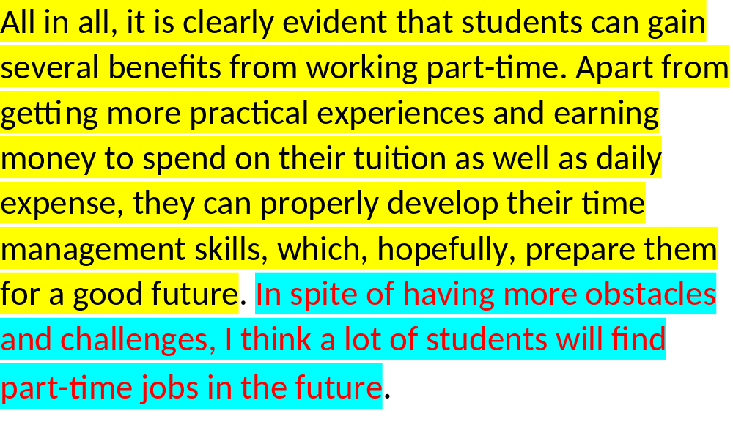

Conclusion
Summary of Main Ideas
Promise in the future

Slide 13
Some useful expressions for advantage-disadvantage essays
Introduction: thesis statement
- The following sections will mention both the benefits and difficulties of N/ Ving. (of working part-time)
- The following paragraphs will discuss the advantages and disadvantages of N/ Ving. (of studying abroad)
- In this essay, the benefits and difficulties of N/ Ving (of travelling) will be discussed/ mentioned/ presented.

Slide 14
Body paragraph 1: advantages/ benefits/ positive effects/ positive impact
The advantages of N/ Ving seem obvious.
Ex. The advatages of playing sports seem obvious
There are some benefits of N/ Ving.
N/ Ving has many positive effects.
N/ Ving provides people/ local people/ residents/ students/ learners/ users/ passengers/ customers/ players many (noticeable/ remarkable) benefits.

Slide 15
Phrases for listing
First,……/ First of all,……….. / Firstly,………….
Second, ………./ Secondly,………./ In addition,…………… / Moreover,……….. / Also, ………..
Finally,…………./ Last but not least, …………..

Slide 16
Body paragraph 2: disadvantages/ problems/ difficulties/ negative effects/ negative impact
On the other hand, there are also difficulties for someone to Verb.
Ex. On the other hand, there are also problems for someone to study abroad.
However, Noun/ V-ing also has some negative effects.
Ex. However, working part-time also has some negative impacts
On the other hand, people also experience disadvantages/ problems/ drawbacks of Noun/ Ving.
Ex. On the other hand, people also experience some drawbacks of working part-time.

Slide 17
Sentences used to list disadvantages
The first disadvantage is/ refers to Noun/ Ving. (culture shock/ adapting to new culture)
The first problem/ challenge/ difficulty is that S + V.
Another disadvantage is Noun/ Ving. (high school fees/ spending a lot of money)

Slide 18
Sentences used to list disadvantages (cont)
Another disadvantage is that S + V…… .
Ex. Another disadvantage is that students can’t concentrate on their studies
In addition, S + V…………../ Moreover, S + V…...
Ex. In addition, students do not have much time to rest/ Moreover, students have to stay up late to prepare their lessons.
As well as this, S + V ….
Ex. As well as this, students also get trouble with their homework/ doing their home work.
The final disadvantage refers to Noun/ Ving.
Ex. The final disadvantage refers to students’ health safety
The final problem/ drawback/ negative effect is that S + V.
Ex. The final negative effect is that students have no guarantee of health safety

Slide 19
Conclusion
In conclusion, Noun/ Ving has both advantages and disadvantages. The advantages refers to…., while the disadvantages include ….. Therefore, people should be careful when they decide to Verb
In summary, there are both benefits and challenges (difficulties) of Noun/ Ving. The benefits are …. The difficulties are…. I think people should think carefully before they decide to Verb.
In short,
To sum up,
All in all,
To conclude,

Slide 20
PRACTICE
Write an essay to discuss both the benefits and difficulties of living in a small or nuclear family.
Write an essay to discuss the advantages and disadvantages of studying abroad.
Write an essay to discuss both the benefits and drawbacks of having a part-time job for students.
Write an essay to discuss both the benefits and problems of travelling.
Write an essay to discuss the positive and negative effects of using social networks.
Write an essay to discuss both the benefits and disadvantages of having long holidays.
Write an essay to discuss the advantages and problems of playing sports to improve health.
Write an essay to discuss both the benefits and negative effects of eating fast foods.
Write an essay to discuss both the benefits and challenges of studying English in Vietnam.
Write an essay to discuss the causes and solutions for environmental pollution.

Slide 21
ESSAY WRITING (PAGE 201)
TASK 2: Writing an advantage-disadvantage essay
Read the following essay to answer these questions.
1. How many paragraphs are there?
2. Which paragraph tells the readers about the overview of the essay?
3. What is the essay mainly about?
4. Which paragraph tells the readers about the summary of the essay?
5. What is the second paragraph mainly about?
6. What is the third paragraph mainly about?

Slide 22
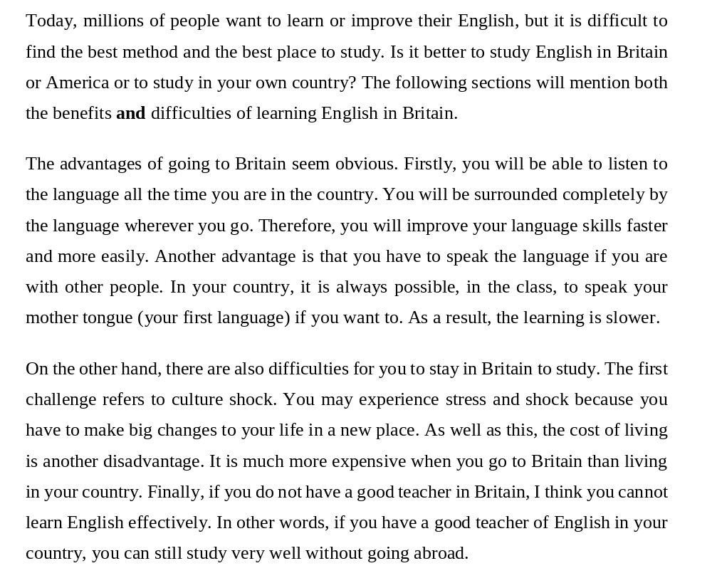
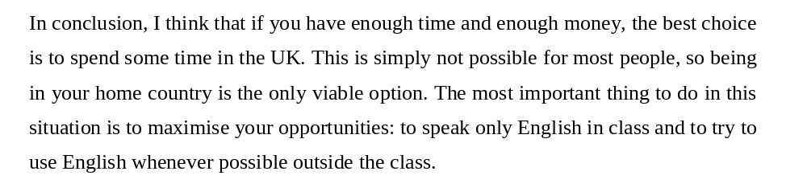
1. How many paragraphs are there?

Slide 23
The first paragraph
Today, millions of people want to learn or improve their English, but it is difficult to find the best method and the best place to study. Is it better to study English in Britain or America or to study in your own country? The following sections will mention both the benefits and difficulties of learning English in Britain. (Thesis Statement) – gọi là câu mở bài

Slide 24
The second paragraph
The advantages of going to Britain seem obvious. Firstly, you will be able to listen to the language all the time you are in the country. You will be surrounded completely by the language wherever you go. Therefore, you will improve your language skills faster and more easily. Another advantage is that you have to speak the language if you are with other people. In your country, it is always possible, in the class, to speak your mother tongue (your first language) if you want to. As a result, the learning is slower.
      The Topic sentence (The advantages of going to Britain seem obvious)
      (Gọi là Câu chủ đề advanatges)

Slide 25
The third paragraph
On the other hand, there are also difficulties for you to stay in Britain to study. The first challenge refers to culture shock. You may experience stress and shock because you have to make big changes to your life in a new place. As well as this, the cost of living is another disadvantage. It is much more expensive when you go to Britain than living in your country. Finally, if you do not have a good teacher in Britain, I think you cannot learn English effectively. In other words, if you have a good teacher of English in your country, you can still study very well without going abroad.
The Topic sentence (On the other hand, there are also difficulties for you to stay in Britain to study) (Câu chủ đề về disavantages / difficulties)

Slide 26
The last paragraph
In conclusion, I think that if you have enough time and enough money, the best choice is to spend some time in the UK. This is simply not possible for most people, so being in your home country is the only viable option. The most important thing to do in this situation is to maximise your opportunities: to speak only English in class and to try to use English whenever possible outside the class.
      Đoạn kết luận: kết luận lại các ý đã nêu trong bài
      - Summarize the key supporting ideas you discussed throughout the work

Slide 27
BENEFITS AND DIFFICULTIES OF
LIVING IN A SMALL OR NUCLEAR FAMILY
BENEFITS
Parents can share parenting responsibility and financial duty
Children can get the same amount of attention, love and care from the parents.
The basic needs of children can be met by parents if they have fewer children.
Parent can afford to look for a better place to live and rear their children
DIFFICULTIES
Can’t get love from grandparents
It prevents a child from becoming a well-rounded individual
  - It makes the child a selfish individual.
  - a small family makes parents overprotective and excessively attentive
Children may not spend a lot of time with adults at home if both parents are working
prevents the kid from learning the responsibility
The child may feel loneliness

Slide 28
ADVNATAGES AND DISADVANTAGES OF
STUDYING ABROAD
Advantages
easy to learn foreign language
able to learn advanced knowledge and technology
learn about different cultures and customs
get new experience
help us to become more independent
Disadvantages
feel lonely/ suffer from homesick
get communication problems
cost lot of money
get culture shock/ difficult to adapt new culture
get social exclusion/ get racial discrimination

Slide 29
Topic 3: ADVANTAGES AND DISADVANTAGES OF
HAVING A PART-TIME JOB
ADVANTAGES
Helps you gain work experience and more confidence in real life
Get/ earn more money to support for study and daily expenses
Be able to manage money better
Have an opportunity of networking and collaborating with other people
Have a good skill of time management
DISADVATAGES
Less time for homework and effect your study.
Increase stress and health problem.
Balancing work and study can be more stress for student.
Student may have lower grade in the school. Employment can play a constraint for student’s study and sleep time
Lack of job security because you face lots of risks from part-time job

Slide 30
Topic sentence:
One the one hand, students can benefit a lot from part-time jobs
Having part-time jobs offers students lots of advantages
Working part-time while in the university offers various advantages to the students
On the other hand, there are a lot of disadvantages of having a part-time job for students

Slide 31
Nowadays more and more students are trying to find a part-time job. In fact, there are a lot of reasons for it, but the most common one is lacking of money. It may be due to a bad economical situation of students or they just need money for their entertainments as well as other necessary daily expenses. In general, it is not very easy for most of students to start a part-time job at the first time. In this essay, both the advantages and disadvantages of having a part-time job will be discussed in more detail.
On the one hand, working part-time while in the university offers various advantages to the students. First, students can make money by working, which supports their study and daily expenses. Second, they will have gain more work experiences from part-time jobs because they have to work in different social environments. In addition, the experiences which they get, will help them overcome many different situations in life easily. Third, the part-timers have opportunities to contact work with many different people, this will help them get a dynamic skill of collaborating. Last but not least, students can obtain a good management skill of time and work which later helps them find a good job in the future as well.
On the other hand, there are also many disadvantages of having a part-time job. The first disadvantage is that student’s learning result can become worse because they have less time to do all school work as well as participate in extra- activies given by teachers. Next, as students have a busy schedule and have less time for themselves, they may face an increase in stress and health probem. Another negative effect is that they will lose fun and excitment entertainments with other students and friends when they can not join in friends’ activies. Lastly, part timers usually do not get the pays for health insurance, holidays and sickness, etc. If they fell ill then they won't get paid for that.
In conclusion, there are many advantages and disadvantages of having a part time job when being a student. Having a part time job is good because of many benefits it brings. But students should think very carefully before they decide to get a part-time job.

Slide 32
BENEFITS AND PROBLEMS OF TRAVELING
BENEFITS
learn new languages and cultures
expand your knowledge
make new friends/ meet new friends
become more self-confident and independent
have a good memories in life time
PROBLEMS
face communication problems (language barrier)
traveling can be expensive
can get exhausted
get shocks to strange customs, cultures and foods
get homesick

Slide 33
Topic 5: POSSITIVE AND NEGATIVE EFFECTS OF
USING SOCIAL NETWORKS
POSITIVE EFFECTS
bring people together (allow people to improve relationship and make new friends)
an opportunity to widen knowledge and instant information
open chance for doing online business (create a marketing channel for business)
Allow people to share photos and video,…
NEGATIVE EFFECTS
face health problems
get distracted from study
waste lots of time
websites are not always completely secure (black websites with, bad social networks may have problems in humiliation and being a victim of blackmail)

Slide 34
Nowadays, social networking has developed very fast and attracted attentions from different age groups including students. Social networking sites allow students or users to communicate and remain in contact with friends, classmates and families. These sites also allow them to find other people with similar interests that they can create a relationship together. Therefore, social networking has improved communication all over the world and even in the schools and universities. In this essay, both positive and negative effects of using social networks will be presented more clearly.
On the one hand, using social networks has a lot of positive effects to the students/ users. The first advantage is that social networking sites bring people together and allow them to improve relationship and make new friends. For example, Facebook allows people to communicate, send photos and text messages. The second advantage is that it is an opportunity to widen knowledge and get instant information quickly. Another benefit is that it opens chance for people to do online business or create a marketing channel. Last but not least, it helps improve living skills and knowledge. For example, pages that teach foreign languages, cooking, communication, sports so you can study without going to class or paying fees.
On the other hand, there are a lot of negative effects of using social networks to the students/ users. Firstly, using social networks can be addictive and the users will waste lots of time if they do not know how to control. Secondly, it can cause cause some health problems for them such as shortsightedness or mental problems when using it a lot. Thirdly, some networking sites are not always secure; therefore violences may happen and the users may become a victim. Last but not least, social networks can lead to the distraction from work and study.
In conclusion, social networking can be useful for knowledge and ifnormation, but also it can be easy to harm and get addicted. Thus, I think the user should use it wisely and think carefully before using it.

Slide 35
6. Write an essay to discuss both the benefits and disadvantages of having long holidays
Benefits | Disadvantages
Long holiday is a great opportunity to travel to different places (Sts are able to experience cultures, history) Sts get more time for entertainment and interesting activities (camping) It is a chance to spend more time with family, relatives and friends A chance for sts to do what they like or helps them take part in a specific course such as English course, cooking course, dancing classes. | Sts will forget their knowledge, the level of knowledge will be on the downturn. Sts may get distracted from their studies and they will forget what they have been learning. sts get addicted to time-wasting habits Long vacation students will face high cost (if they travel to many places) Sts may get bored with long holiday because they don’t know what to do with themselves

Slide 36
7. Write an essay to discuss the advantages and problems of playing sports to improve health
Advantages | Problems
Playing sports can improve your overal health (body, diseases, metal problems,...) Sports activities help players find more friends from playing team sports Sports helps resuce stress Practicing sports helps sts to become more confident | Playing sports can be expensive Playing sports can be time-consuming Playing sports can be exhausted/ get / feel tired Playing sports can lead to serious injuries (hurt your arms, our legs, broke legs

Slide 37
8. Write an essay to discuss both the benefits and negative effects of eating fast foods
Benefits | Negative Effects
Fast food is rather cheap and delicious, suitable for students, workers, travellers and people with little time It is easy to buy and saves time from cooking (Sts spend more time for study) Fast food is popular and quite convenient Fast food is tasty and has lots of choices | Fast food is low quality and nutrient Eating too much fast food can lead to many health problems (diabetes, obesity, blood pressure, teeth decay, cancer, weight gain, allergy) It is unhygienic and contains many artificial colors Using fast food may change social family life and families spend less time together.

Slide 38
Nowadays, many people prefer eating fast food to save time for work and cooking. Therefore, many kinds of ready-to-eat foods are sold everywhere and offer a variety of choices for people who have little time such as students, workers and travelllers... Processed food plays an important role in people’s nutrition and health. In this essay, both the advantages and negative effects of fast food will be discussed in detail.
On the one hand, eating fast foods offers the consummers a lot of advantages. First, fast food is rather cheap and suitable for people with little time. In fact, living in a busy society fast food is a good choice for them because if both partners have to work full time, and they do not have much time to repare family meals. Second, fast food is popular and quite convenient, thus people have more choices from different kinds of ready meals and drinks from street stalls, food stores or at the markets. One can choose what he or she feels like taking for daily meals. Third, fast food often has its additives that appeals many people’s taste. Therefore, and many people like to eat such kinds of food. Finally, fast food consumption can help consumers save money and other expenses. For example, to prepare a meal at home requires lots of extra cost including gas, electricity and water, etc.
On the other hand, there are many negative effects of eating fast food. First, eating too much fast food can lead to many health problems because it is rich in fat, salts, sugar, artificial colors which cause many serious diseases such as diabetes, obesity, blood pressure, teeth decay, cancer, weight gain,...It can be seen that obesity is also on the rise as a result of growing popularity of fast food. Second, some kinds of fast food have low quality and nutrient and if one eats lots of fast food, he or she will face deficiences in vitamins and proteins. In additions, the presence of fast food will lead to the loss of the family tradition of eating together. sharing and talking with each other. Last but not least, selling fast food will use a lot of packaging and this also cause the environment pollution. From using the food wrappers, plastic boxes and bags for drinks, snacks, . These containers are the most common food wastes. These are non-degradable materials and influence our living environment.
In conclusion, fast food has many benefits and negative effects for for people and consummers. The benefits are saving money and time,... The disadvantages are low quality, poor hygiene, healthy problems,...In this situation, consummers need to understand how to choose their healthy food to improve their health status and spends more time to cook their meals at home instead of eating fast food.

Slide 39
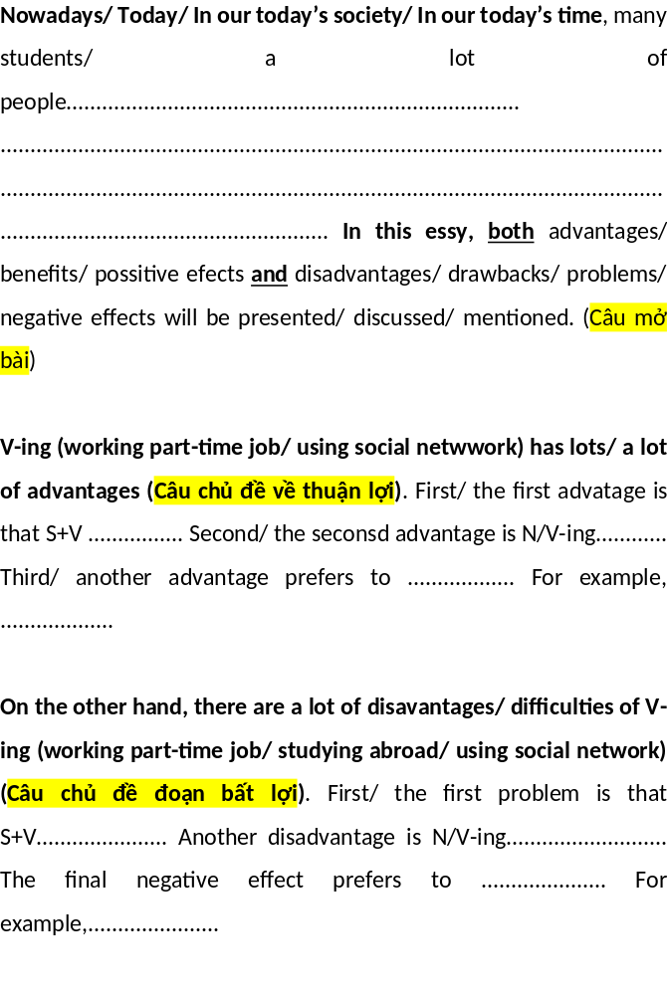

Slide 40
9. Write an essay to discuss both the benefits and challenges of studying English in Vietnam
Benefits | Challenges
Studying English helps Sts open the door to the new cultures English helps sts to get better jobs and good opportunities to change their life. Teachers have interesting methods to motivate Sts to learn English better the teachers have good experiences and enthusiasm (Good library in Cantho University with lots of English books) | Over-crowded classes may not help students learn E better. Vietnamese teachers may not have good accent as foreign teachers/ native speakers Students lack of environment to practice speaking English with foreigners the program of study in school is rather heavy

Slide 41
Nowadays, learning English becomes important and necessary for people of all ages. People learn English for many different purposes such as employment, communication, getting to know the cultures, .... Thus, English is now widely used in many countries as a second language. Besides, teaching and learning English are also due to different conditions and learning environments. Learning English in Vietnam is also important for young people and students. In this essay, both the benefits and challlenges of studying English in Vietnam are discussed.
On the one hand, studying English in Vietnam has a lot of benefits for students/ learners. First, studying English helps them open the door to the new cultures around the world. Obviously, learning English languge helps the learners read, communicate and get to know many countries through different cultures. Second, English helps students find a better jobs as well as offers them good opportunities to change their life. Third, Teachers have interesting teaching methods, skills and experiences to motivate students to learn English better. Last but not least, Cantho University has a big library with lots of English books and materials which helps them in learning English better.
On the other hand, there are a lot of challenges of studying English in Vietnam for many students/ learners. The first chanllenge is that over-crowded classes may not help students learn English better because of lacking practices of neccessary skills like speaking and writing. Second, students lack of environment to practice speaking English with foreigners to help them get a good pronuniation skill. Third, some Vietnamese teachers may not have good accent as foreign teachers; therefore, students may not speak English in a smooth way of natural speaking as the native speakers. Finally, the school program is rather heavy due to its basic requirement for skills development involved in English teaching according to six levels of language proficiency, this requires students to spend a lot of time on self-study and practice necessary exercises beside studying in their English classes.
In conclusions, learning English in Vietnam has both advantages and challenges for students/learners. The advantages include cultural understanding and communication, better jobs and good teaching methods, etc. The challenges may be over-crowded classes, lack of communication environment with foreigners. The English language learning environment can vary depending on the teaching and learning environment in Vietnam, and it is essential that both learners and teachers need to overcome obstacles to promote learners' effectiveness.

Slide 42
10. Write an essay to discuss the causes and solutions for environmental pollution.
CAUSES | SOLUTIONS
Industrial wastes are the main sources of soil and water pollution Vehicles emissions also pollute the environment Rapid growth of urbanization and industrialization are causing the environmental pollution The growing population and humand demands of using natural resources are harmful to our environment and planet. | The goverment should have strict measures for management of industrial wastes People should be aware of using means of puplic transport The government should have a long term plan for urban and industrial development The government should have appropriate policies for inter-regional population growth and rational use of natural resources

Slide 43
Writing a Letter/ email to answer your friend

Slide 44
Format of a letter or email or postcard
Three main parts:
Greetings (Chào hỏi)
Main content (Nội dung chính)
Closing or ending (Phần kết thúc)

Slide 45
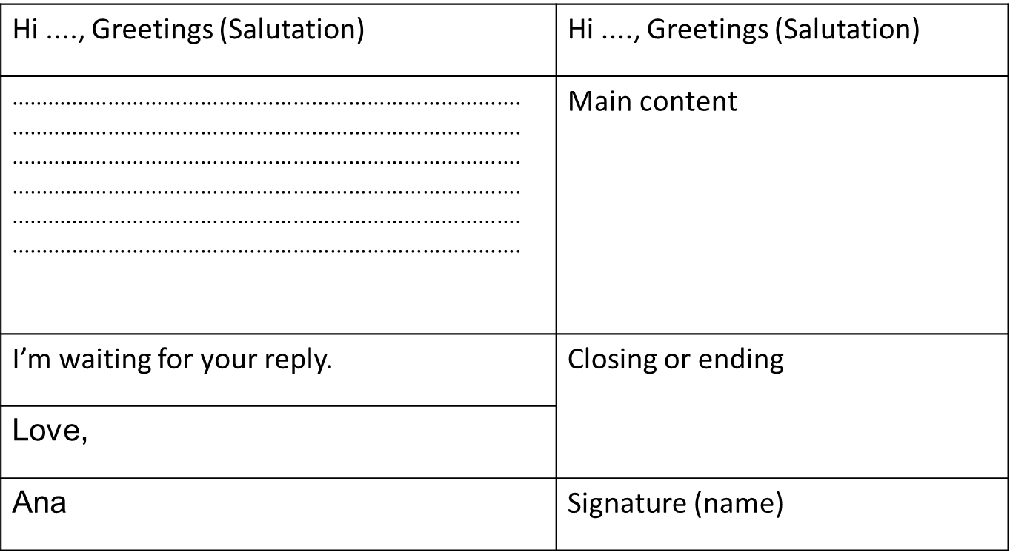
Informal email or letter/ postcard

Slide 46
Formal email or letter
Dear ...., Greetings (Salutation) | Dear ...., Greetings (Salutation)
................................................................................... ................................................................................... ................................................................................... ................................................................................... ................................................................................... ................................................................................... | Main content
I’m looking forward to receiving your response. | Closing or ending
Sincerely yours,
Anna Brown | Signature (name)

Slide 47
Greetings (chào hỏi)
Thân mật:
Hi Nam,
Hi Hoa,
Trang Trong:
Dear Nam,
Dear Hoa,
Trang trọng hơn:
Dear Mr. Nam,
Dear Mrs. Hoa,
Dear Sir (s) or Madam (s),

Slide 48
Opening (hỏi thăm)
I am happy/glad to get your email/letter.
Thanks a lot for your writing. It’s great to hear from you.
How are you and your family? Hoping you are fine.
We haven’t seen for a long time.
It’s great to hear (know) that ……..

Slide 49
Main content (lý do viết thư)
I am writing to answer your question (s) about …………………
I am writing to ask for the information about ……………………
I am writing to inform/ explain/ tell you that ………………..
I am writing to give you some advice on……

Slide 50
Main content (cont)
As you told me, I…………. (như bạn đã nói với tôi, tôi....)
Regarding your question, I .....(liên quan tới câu hỏi của bạn, tôi...)
As you mentioned in the previous letter/ email, ………
(như bạn đề cập trong thư trước)
As you started in the letter, I…….(Như bạn đã bắt đầu trong thư, tôi...)
I would be grateful if you……………….(Tôi rất biết ơn nếu bạn...)

Slide 51
Ending (cuối thư)
I look forward to your reply. (formal)
I look forward to meeting you soon.
I look forward to getting your good news.
Let me know if you need any more information
Please response at your earliest convenience

Slide 52
Signning off (Ký tên)
1. Thân mật
  Best wishes, (lời chúc tốt đẹp nhất)
  Take care, (Bảo trọng)
  Best, (Tốt đẹp nhất)
  Bye, (Tạm biệt)
2. Trường hợp trang trọng (khi có đề cập tên như Mr. Ha, Mrs. Hoa,…)
  Your Sincerely, (thân ái)
  Best regards, (Trân trọng)
  Warm regards, (Trân trọng)
3. Trường hợp trang trọng chưa đề cập tên (Dear Sir, Dear Madam)
  Yours faithfully, (Trân trọng)

Slide 53
Useful expressions for informal and formal letters or emails
Main parts | Informal letters/ emails | Formal letters or emails
Greetings/ Salutation | Dear (first name), Hi, Hello, | Dear Sir/Madam, Dear Mr/Mrs (surname),
Beginnings | It was nice to hear from you. It’s been ages since I’ve heard from you. How are you? Hope you and your family are doing well. I am writing to let you know ... | With reference to our telephone conversation yesterday (about) ... Thank you for your email regarding ... I am writing on behalf of ... I am writing to draw your attention to...
Making a request | You don’t mind …ing (…) (for me), do you? Do me a favor, will you? Would it be possible for you to? Can/Could I ask you to? | I would appreciate if you could ... I would be most grateful if you would ... Would you be so kind ... I was wondering if you could ...
Closing or Endings | Give my love to ... Hope to hear from you soon. Just give me a call if you have any questions. | I look forward to hearing from you If you require any further information, please don’t hesitate to contact me. Please feel free to contact me if you have further questions
 | Love, Lots of love, All the best, Best wishes, Regards, | Yours sincerely, (Dear + name) Yours faithfully, (Dear Sir/Madam)

Slide 54
Topic 18: Write a letter to your friend about a restaurant
Dear Nam,
I'm glad to receive your letter today. I am writing this letter to tell you about one of my favorite restaurants. Minh Kieu is a popular restaurant in my neighborhood. It is located in Hai Ba Trung street, Can Tho. It is a small Vietnamese restaurant. Its menu has many delicious dishes such as fried chicken, sour soup, hot pot and soft drink. I go to this restaurant with my family and friends twice a week. The best dish is sour soup with fish which is served with special fish sauce. The restaurant's staffs are very friendly and thoughtful. I also have an unforgettable experience at this restaurant. I love this restaurant so much. I hope you will have a chance to go to this restaurant with me.
Best wishes,
Lan

Slide 55
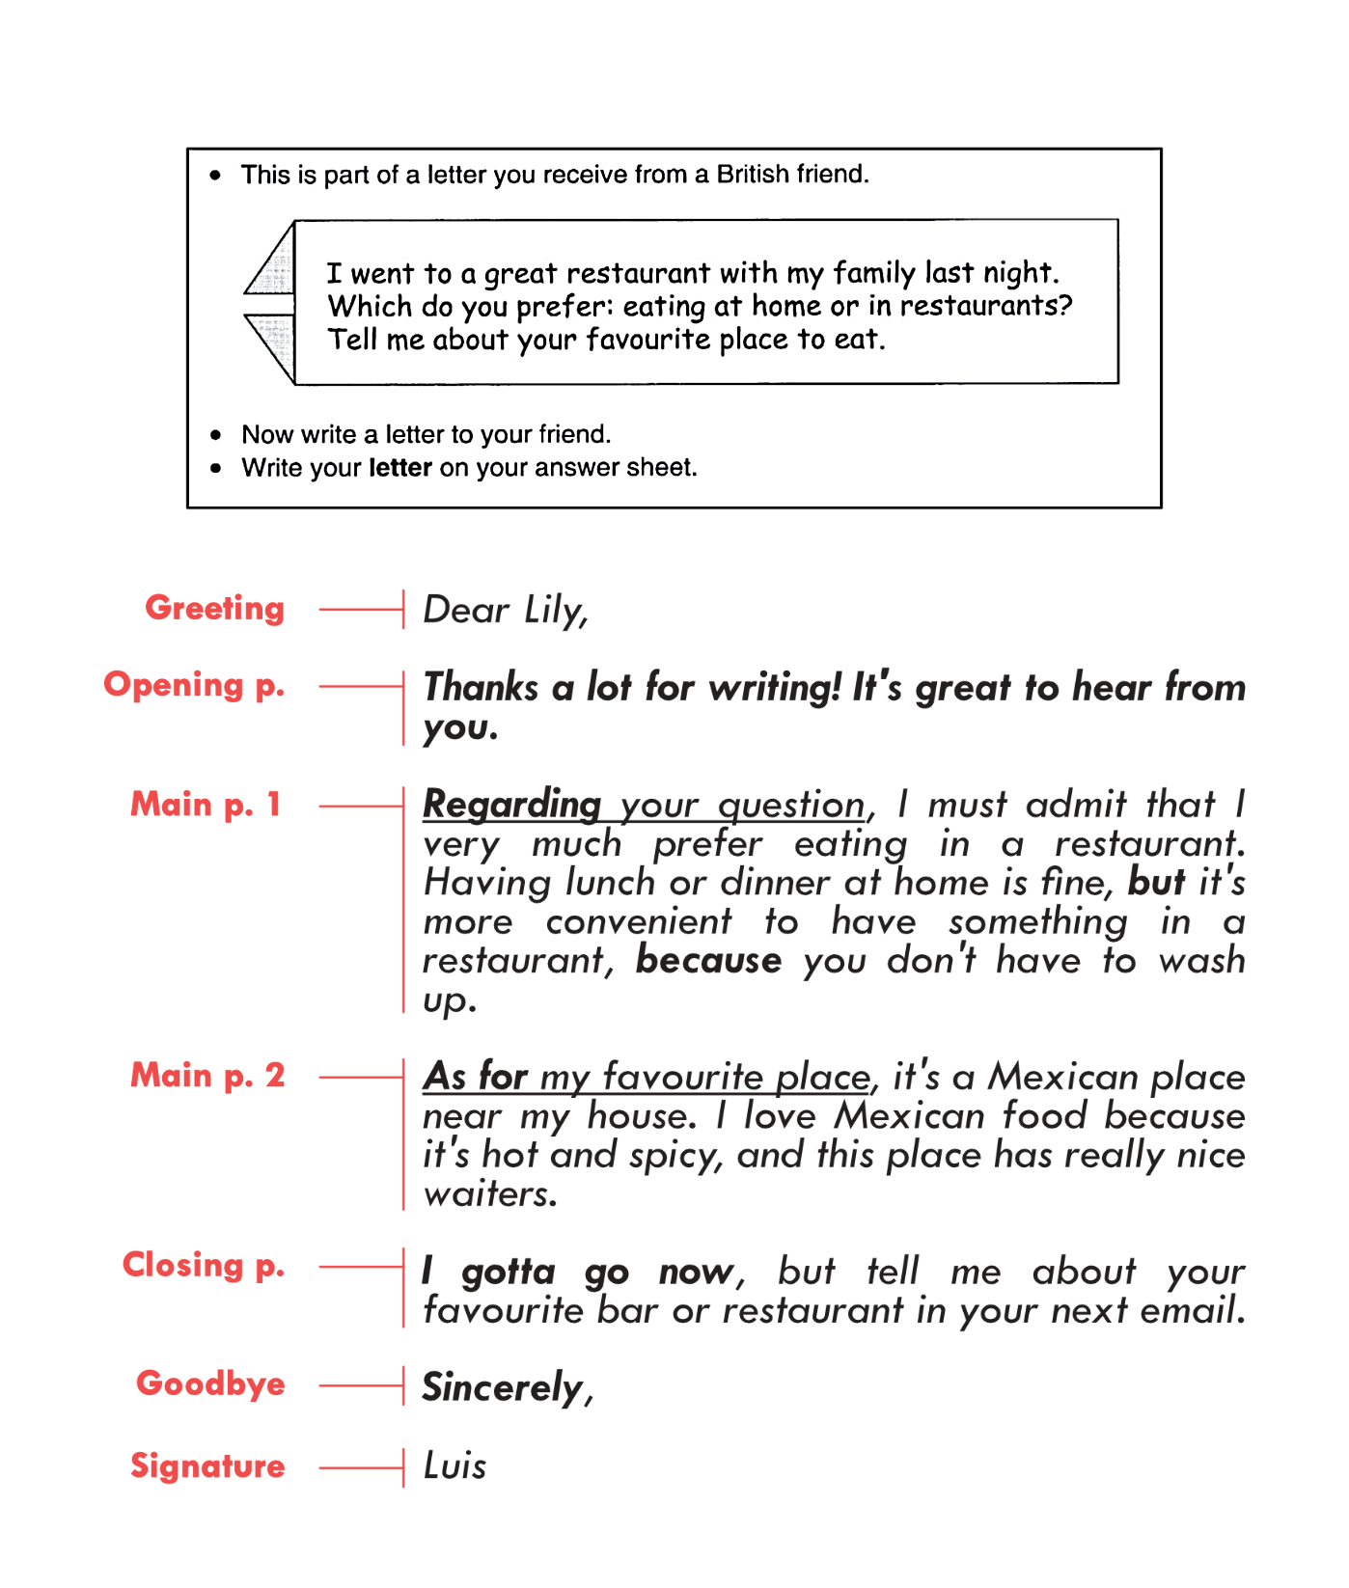
Sample Letter

Slide 56
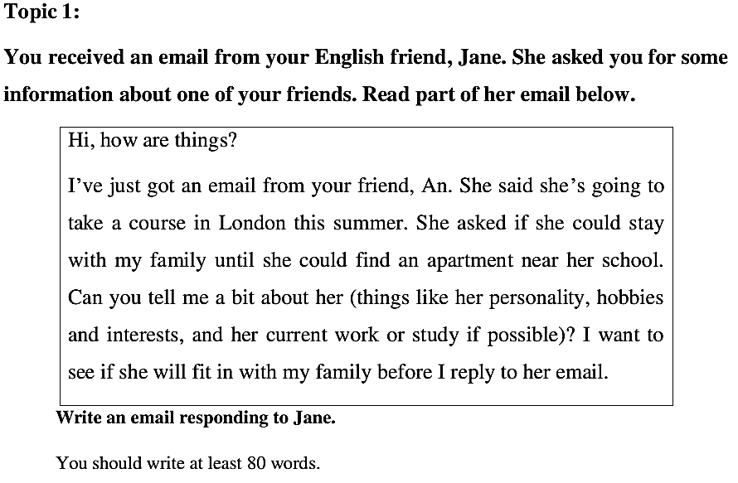
Writing an Email/ Letter

Slide 57
Personality: nhân cách, tính cách
  Ex. She is a good tempered person
  She is very friendly
  (funny; intelligent; friendly; hard-working, honest, attentive; pessimistic; faithful)
Hobbies and interests:
Ex. She likes cooking/ shopping/ listening to music/ swimming/ travelling
Current work/ study:
Ex. She is studying English in Cantho University
She is studying tourism and culture in Cantho university

Slide 58
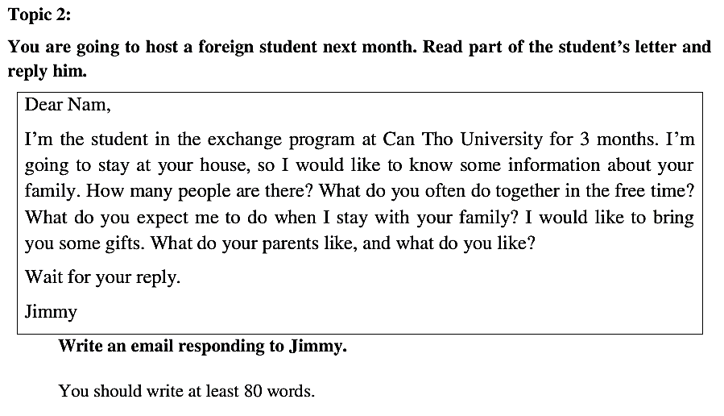
Writing an Email/ Letter

Slide 59
to host (v) to welcome/ to receive
Ex. In my family, there are 4 members/ people (my father, my mother, my younger brother/ sister and me)
Ex. We often cook together/ watch TV together in our free time/ do the gardening together,…
Ex. I expect you to help my family with house work
Ex. I expect you to share the housework/ to do the gardening with my family
Ex. I would like you to bring me some chocolates and candies
Ex. You should bring them some fruits/ flowers

Slide 60
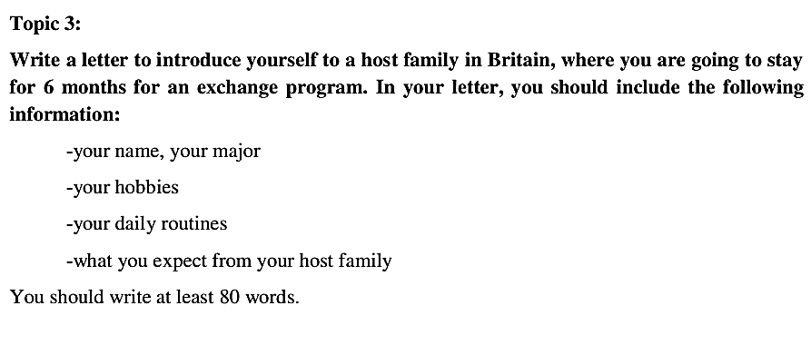
Writing an Email/ Letter

Slide 61
My full name is……………
My major is………………
In my free time, I like playing football/ going swimming
Daily routines:
Ex. I wan to tell you about my daily activities. In the morning, I often get up at 6.30 a.m. I brush my teeth and wash the face and then I have breakfast. At 7.30 a.m, I go to school. I finish my study at 11h30. I have lunch at 12h30. I have 1 hour to take a nap. At 1.30 pm, I go to school again. I come back home at 17 o'clock. I do some sports from 17h30 to 19h. After that, I cook dinner with my mother and take a bath. I often spend hours for relaxing from 20h to 21h30. I go to bed at 21h45.
I expect my host family to help me with my study/ cooking/ housing

Slide 62
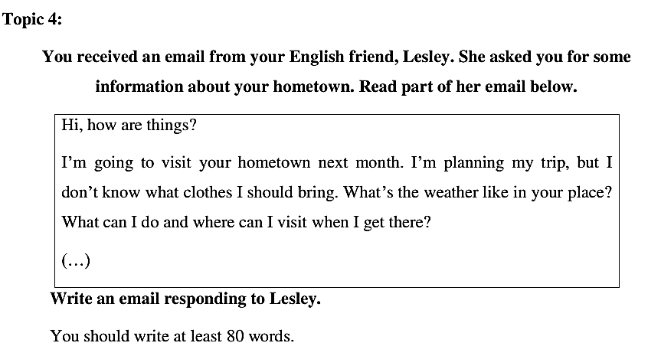
Writing an Email/ Letter

Slide 63
Clothes:
Ex. You should bring T-shirts/ shirts/ jeans
Weather:
Ex. The weather in my hometown is pretty nice. It is often sunny/ rainy/ very hot in summer/ cool in my living place
What to do:
Ex. You can play sports/ go swimming/ go fishing,….
Where to visit:
Ex. You can visit Phong Dien fruit gardens, Cai Rang loating market, pedestrian bridge,..

Slide 64
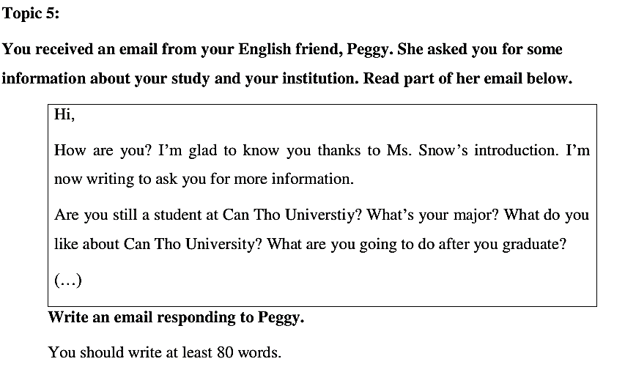
Writing an Email/ Letter

Slide 65
Dear Peggy,
I am very happy/ glad to receive your email. How are you and your family? I am writing this email to give you some information about my study and my institution. Now, I am a final year student at Can Tho University. I major in Information Technology. I like Cantho University because it’s a big and beautiful university in the Mekong Delta. After graduation, I would like to work for a foreign company in Cantho city. I look forward to your reply. Let me know if you need any more information.
Best regards,
Lan

Slide 66
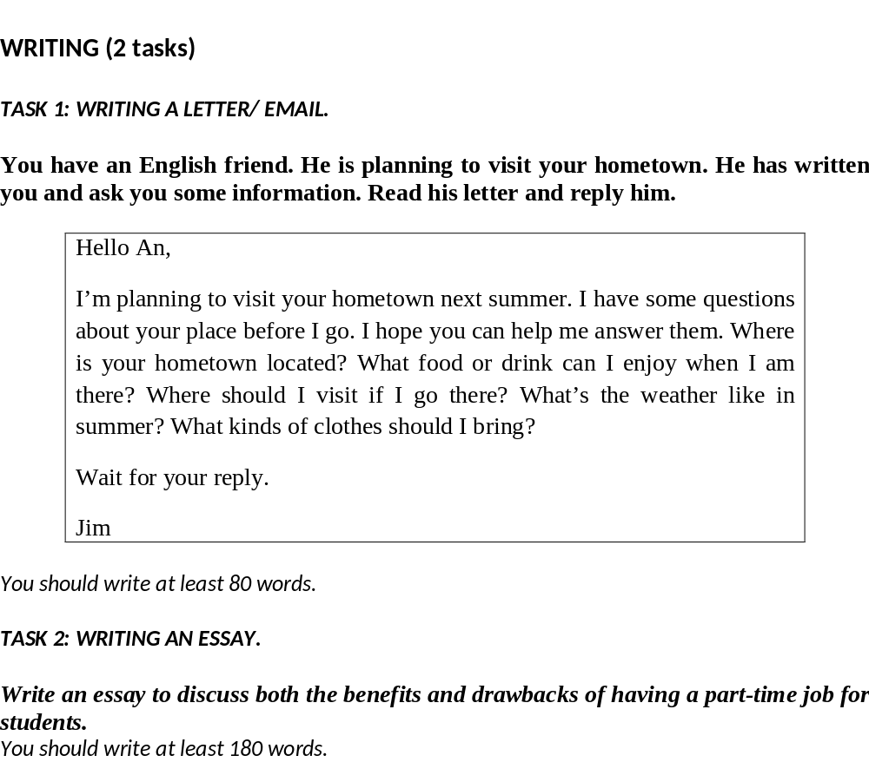
Đề thi KH1-2020-2021

Slide 67
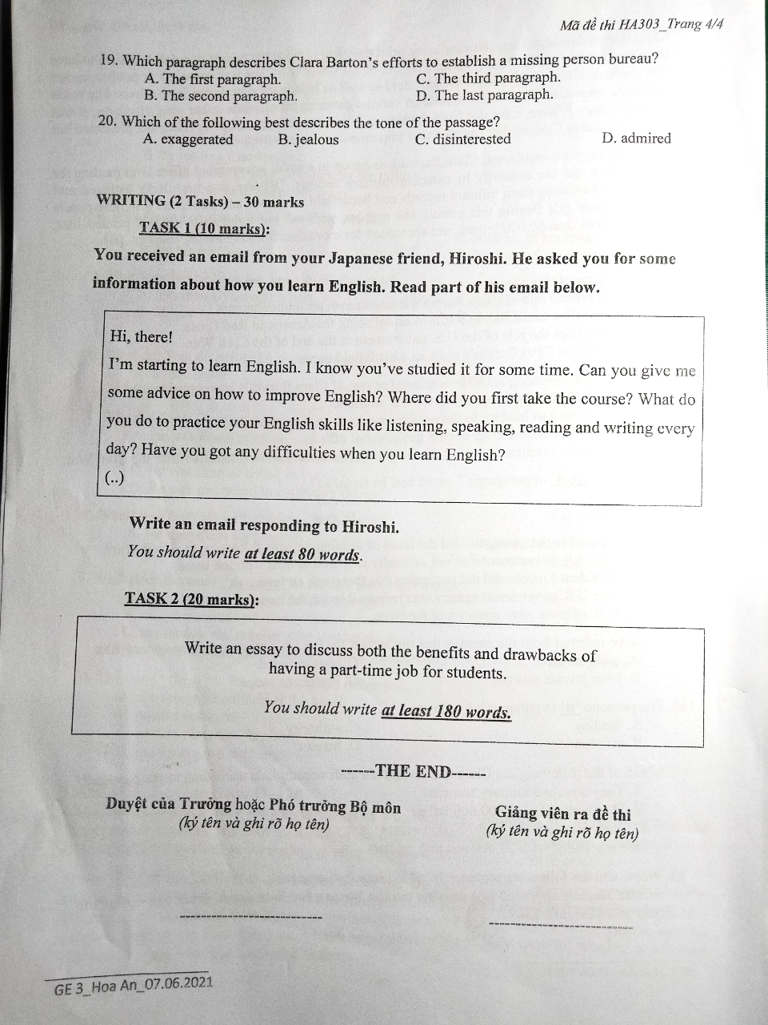
Đề thi HK2 – 2020-2021

Slide 68
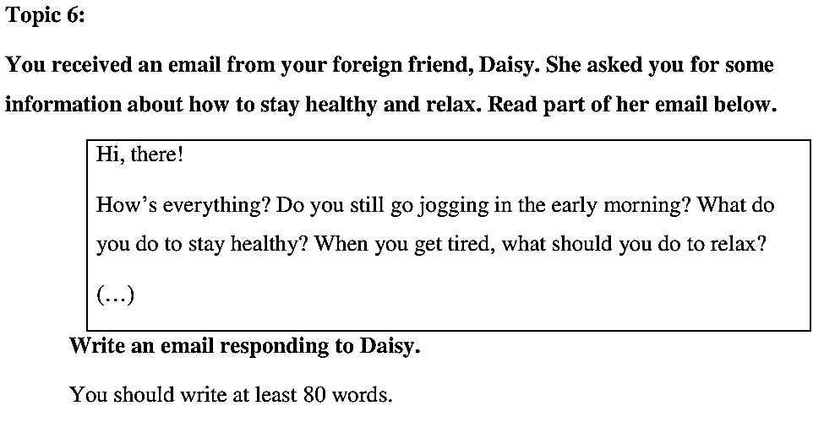

Slide 69
- I still go jogging in the morning every day.
- To stay healthy:
  To stay healthy, I often do more physical exercises such as: playing football, volleybal, aerobics, do yoga, go swimming...
  I always eat healthy food, fruit and vegetables
  I have balanced diet
  I drink a lot of water
  I sleep 8 hours a night
  I don’t smoke or drink alcohol
Relax:
  When I feel tired, I often listen to music, read books, go out with friends, drink coffee
  do yoga
  I practice meditation
  I go shopping

Slide 70
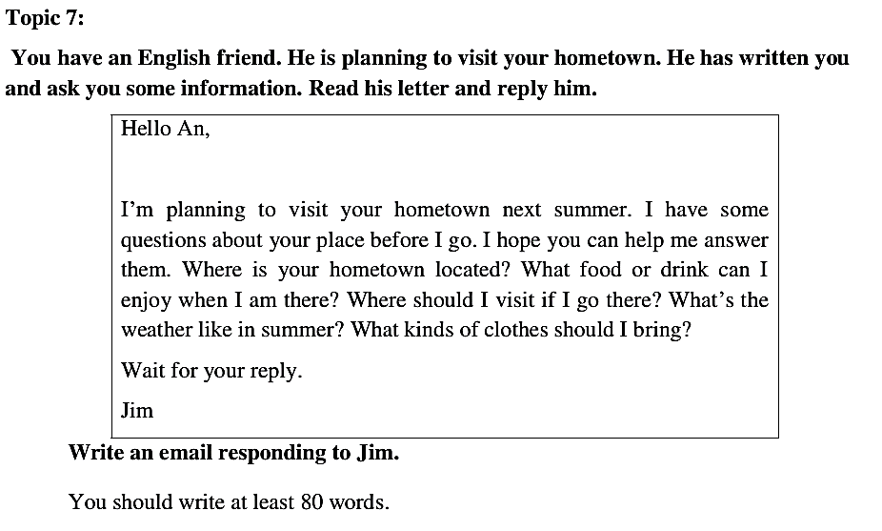

Slide 71
Hello Jim,
I’m very happy to receive your email/ letter. How are you and your family? Hopping you are fine! Regarding your questions, I am writing this email to answer your questions.
Hometown: My hometown is located in a rural countryside called Long My/ My hometown is Vi Thanh city/ Hau Giang province
Food/ specialties: When you come to my hometown, you can enjoy some specialties such as: sour soup with fish, Xeo/pan Cake, Khot cake/ fried shrimp cake, beef noodle soup, spring rolls, grilled snake head fish/ catfish, coconut candy, rice noodle soup, ....
Drink: You can drink/ enjoy: Coconut water, pineapple juice, pomelo juice,
Weather: In my hometown, it’s rather hot in the summer. There are a lot of rainfalls in the summer.
Clothes: Jeans/ shorts + T-shirt/ shirt (In my hometwon, you should wear.........and.........)
Best wishes,
An

Slide 72
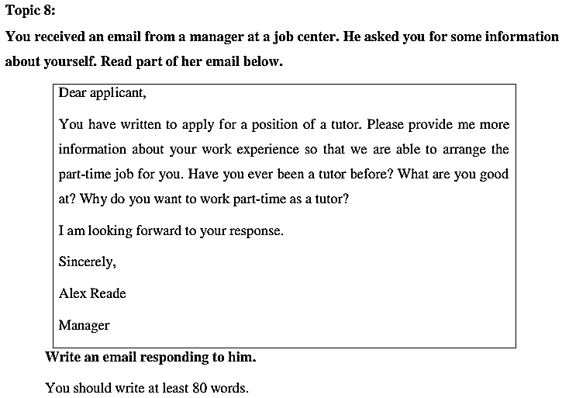

Slide 73
Dear Sir,
My name is............I’m a student at CT University. My major is ..................I have ever been a tutor for 2 years. I love my tutoring job. I teach a lot of young students from 10th to 12th grades. I have lots of experience in tutoring. I am good at Maths and this is my favourite subject. I want to work part-time as a tutor because I want to earn some money to support my study and my daily expenses in my student’s life.
Let me know if you need any more information.
Best regards,
Sincerely,
Lan

Slide 74
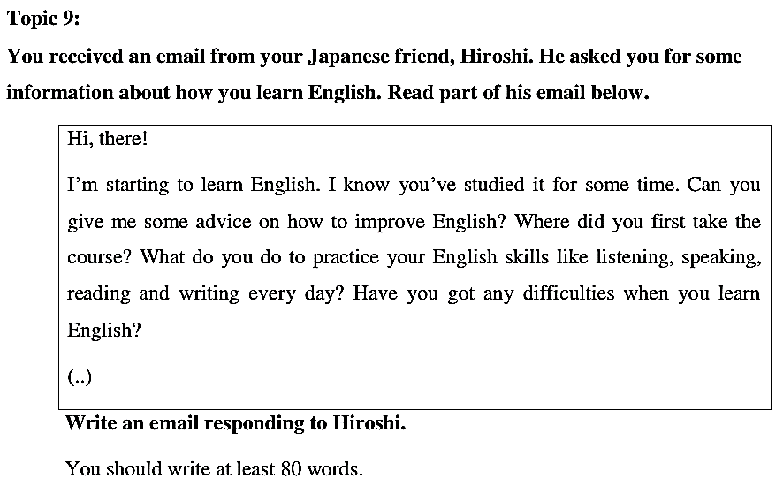

Slide 75
Dear Hiroshi,
I’m very happy to receive your email. How are you and your family? Hoping you are fine! Regarding your questions, I am writing this email to give you some advice about how to improve learning English. First, the English cource I took is at the English Languge Center at CanTho University, this center is a good place for language learners. Second, for my listening skill I often practice listening at home and in the class. Next, for speaking skill I always practice speaking with my classmates. Finally, I often practice writing and reading online whenever I have free time. In fact, I also have difficulties of learning vocabulary and grammatical structures. I think my advice will be helpful to you.
Let me know if you need any more information
Best wishes,
Nam

